Slide 1


Top 25 Golf Courses Worldwide

Slide 2


The Bull at Pinehurst Farms Wisconsin USA

Slide 3


Hidden Glen Country Club Wisconsin USA

Slide 4

Vesper Country Club Massachusetts USA

Slide 5



Warwick Hill Country Club Michigan USA

Slide 6


Fossil Trace Golf Club Colorado USA

Slide 7


Baywood Greens Golf Course Delaware USA

Slide 8

Fishers Island Golf Course New York USA

Slide 9


Tapawingo National Golf Club Missouri USA

Slide 10


Firethorn Golf Course Nebraska USA

Slide 11


Dismal River Club Nebraska USA

Slide 12


White Horse Golf Club Washington USA

Slide 13


Sand Barrens Golf Course New Jersey USA

Slide 14


Kingston Heath Golf Club Victoria AUSTRALIA

Slide 15


Coolangatta & Tweed Heads Golf Club New South Wales AUSTRALIA

Slide 16


Kingswood Golf Club Victoria AUSTRALIA

Slide 17
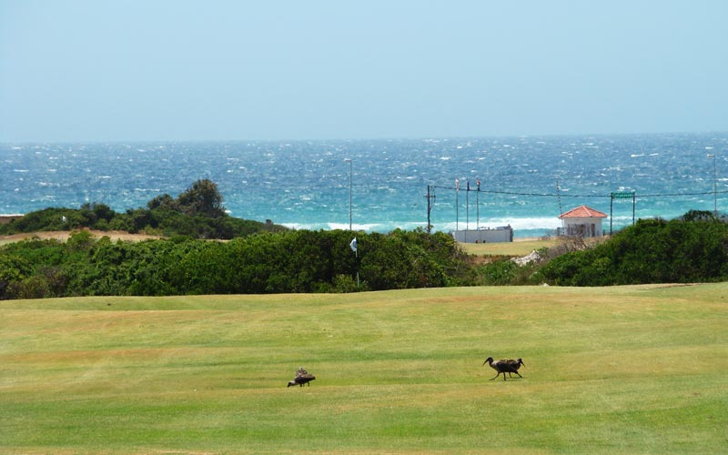

Humewood Golf Club Port Elizabeth SOUTH AFRICA

Slide 18


Royal Cape Golf Course Cape Town SOUTH AFRICA

Slide 19


Samola Golf Estate Knysna SOUTH AFRICA

Slide 20


Nanshan International Golf Club Longkou CHINA

Slide 21


Nine Dragons Admirals Golf Club Zhejiang CHINA

Slide 22


Sanya Luhuitou Golf Club Sanya CHINA

Slide 23


Carnoustie Golf Course Angus SCOTLAND

Slide 24


Abama Golf Club Tenerife SPAIN

Slide 25


Porto Marina Golf Course El Alameen EGYPT

Slide 26


Sofitel La Reserva Cardanales Buenos Aires ARGENTINA

